Slide 1
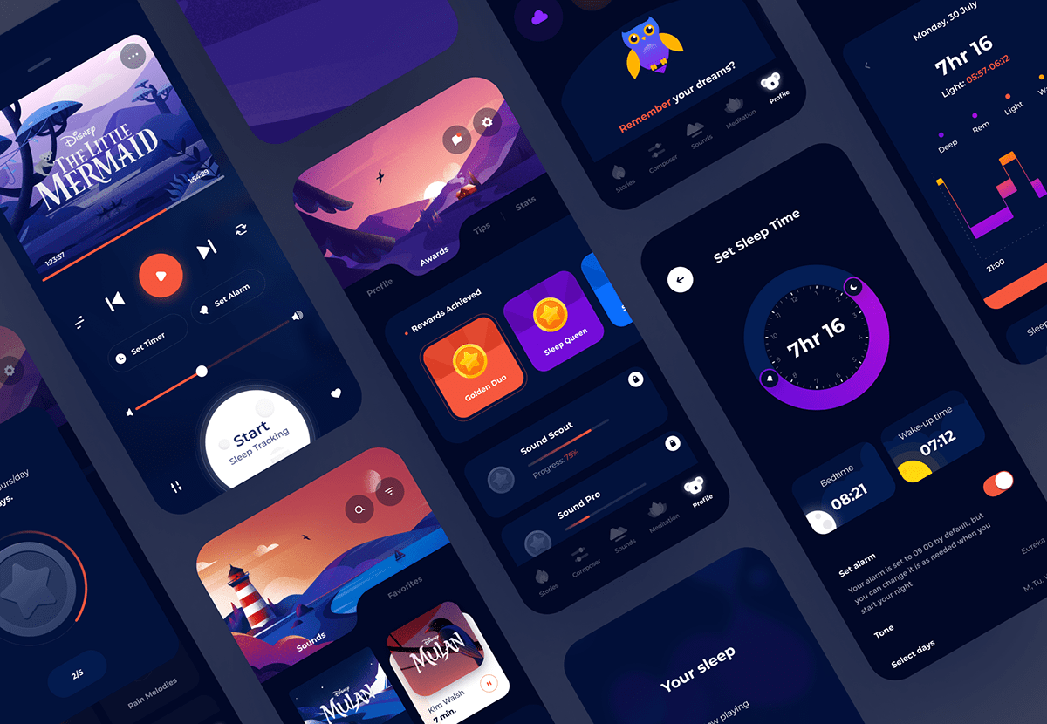
Introduction to UI/UX Design
By Raghav Vain Panthi

Slide 2

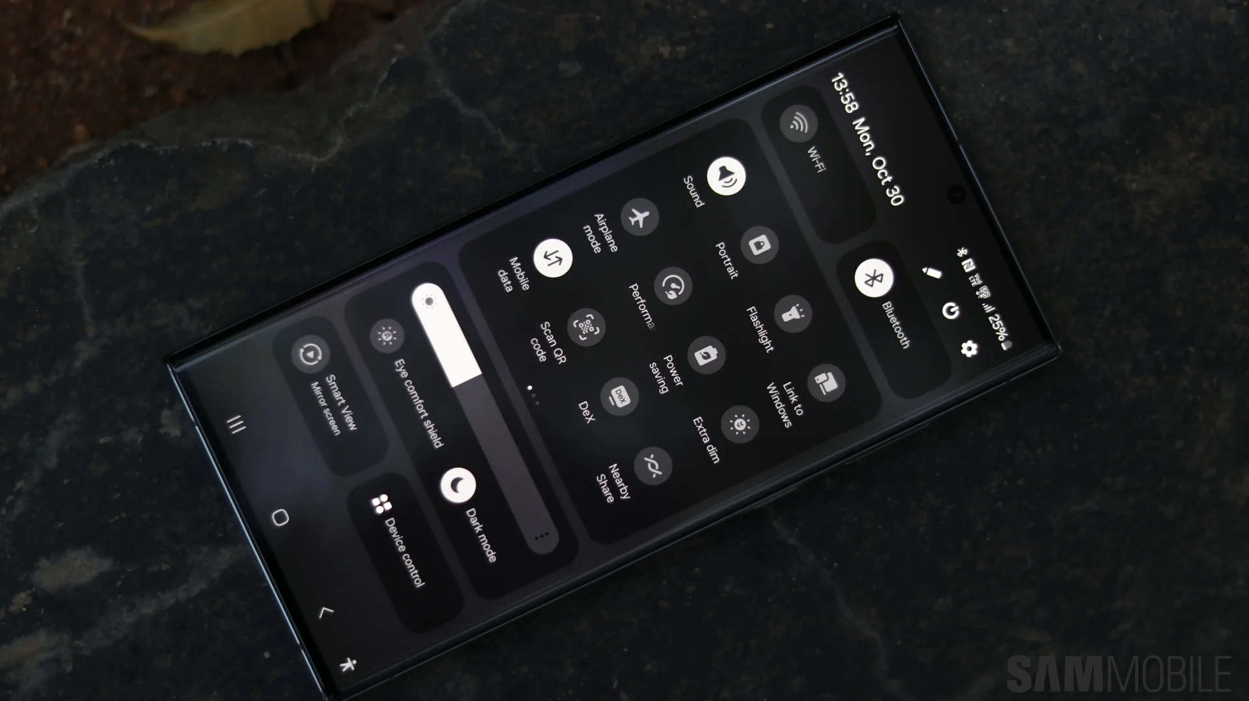
Overview of UI/UX Design
UI (User Interface)
UX (User Experience)
Focuses on the look and feel of a product. Encompasses layout, visual design, and interactive elements.
Example : how a user interacts with an application or a website, using visual and audio elements, such as type fonts, icons, buttons, animations and sounds.
Concerned with the overall user experience. Includes usability, accessibility, and satisfaction.
It includes a person's perceptions of utility, ease of use, and efficiency.
Good design makes good Experience/business

Slide 3

Importance of UI/UX Design
User Satisfaction
Product Usability
Enhances user satisfaction with an intuitive and enjoyable experience.
Improves product usability, making it easy to navigate and use.
Engagement & Retention
Business Goals
Helps in achieving business goals by improving user conversion rates and brand loyalty.
Increases user engagement and retention by providing value and satisfaction.

Slide 4
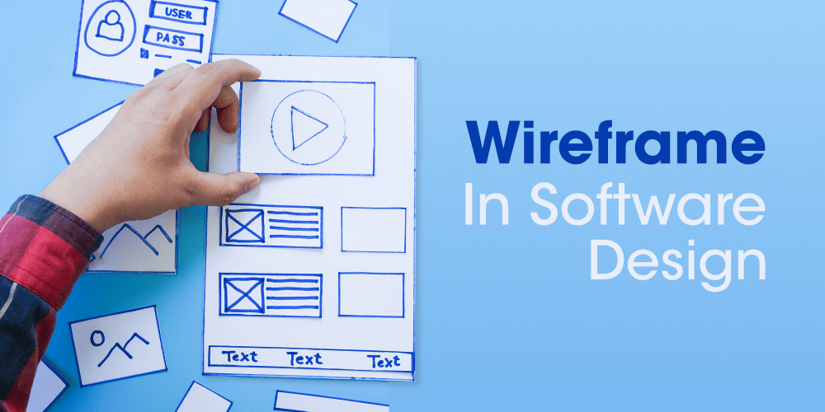
Wireframing
Wireframing is the skeleton of digital design. It’s where ideas start taking shape visually, outlining the structure and functionality of websites, apps, and digital products.

Slide 5





Benefits of Wireframing
Clarify Ideas
Facilitate Collaboration
Helps clarify design ideas before committing to visual design.
Encourages communication and alignment between stakeholders.
Identify Issues
Save Time & Effort
Helps identify potential usability issues early in the process.
Wireframing saves time in many ways. Your designs are more calculated. Your development team understands what they are to construct with the blueprint in mind.

Slide 6
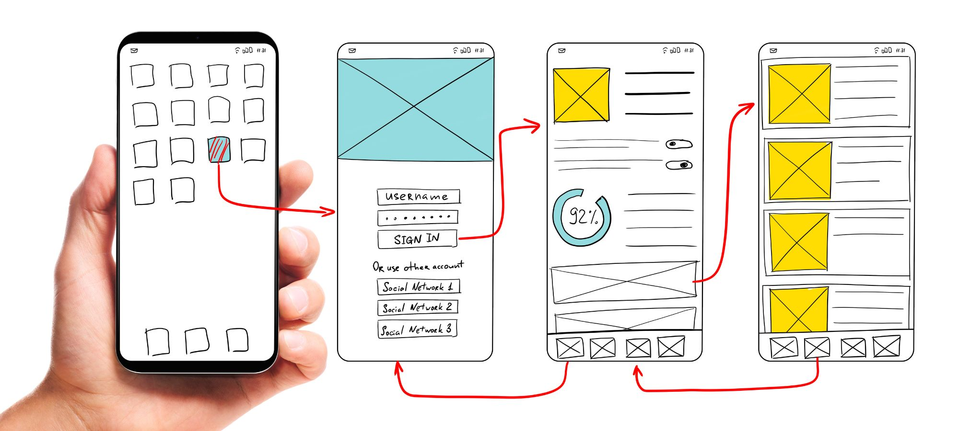
Types/Stages of Wireframing :-
Low-Fidelity
Medium Fidelity
High Fidelity

Slide 7
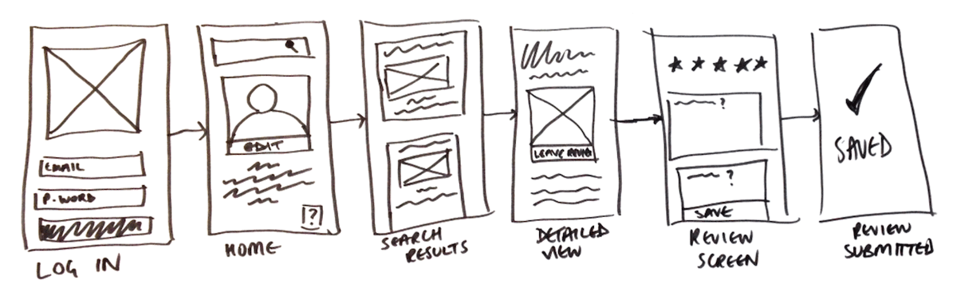
Low Fidelity
Low-fidelity wireframes are basic visual representations of the webpage or an app that serve as the design's starting point. They tend to be fairly rough, created without any sense of scale, grid, or pixel- accuracy.

Slide 8
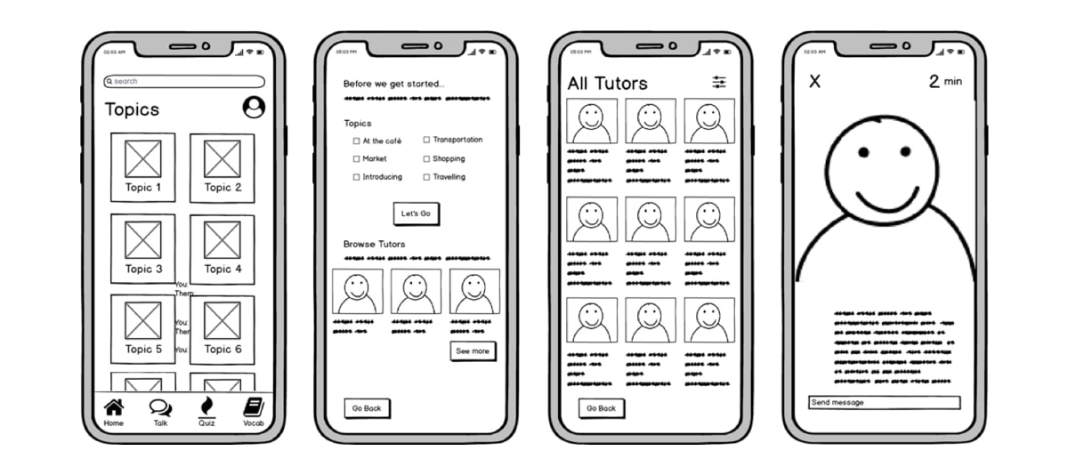
Medium Fidelity
Mid-fidelity wireframes feature more accurate representations of the layout. They avoid images or typography, more detail is assigned to specific components, and features are clearly differentiated from each other.

Slide 9
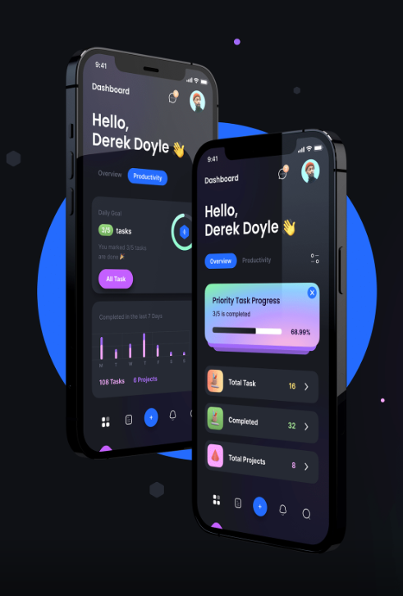
High Fidelity
High-fidelity wireframes boast pixel- specific layouts. They may include actual featured images and relevant written content.

Slide 10
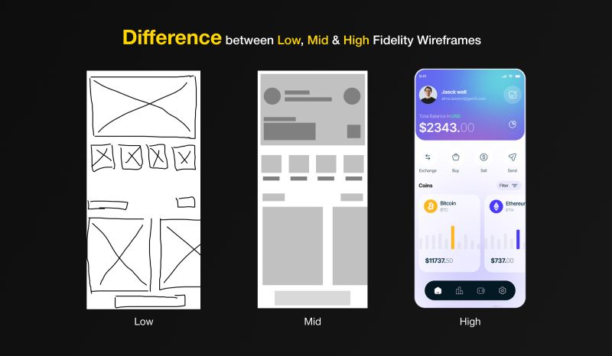

Slide 11

BYE BYE

